Slide 1

Global Climate Trends Analysis
Author: Aaron Darcy Module: Data Operations & Management Date: 12th December 2025

Slide 2
Purpose of the Project
Analyse long-term global temperature change
Extract and process unstructured temperature data via Python web scraping
Engineer climate features useful for analytical dashboards
Build an interactive Power BI dashboard

Slide 3
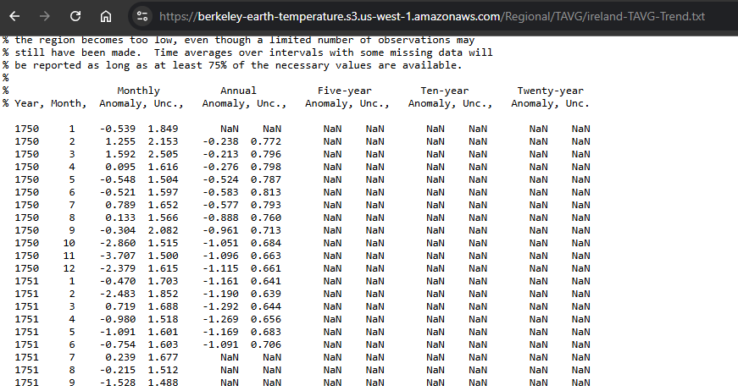
Dataset Overview
Berkeley Earth Temperature Archive
Over 300 Thousand Records
Monthly temperature anomalies per country
A temperature anomaly is how much warmer or colder a given month or year is compared to the long-term historical average for that location
Covers 1850–2020
Source: https://berkeleyearth.org/temperature-country-list/

Slide 4
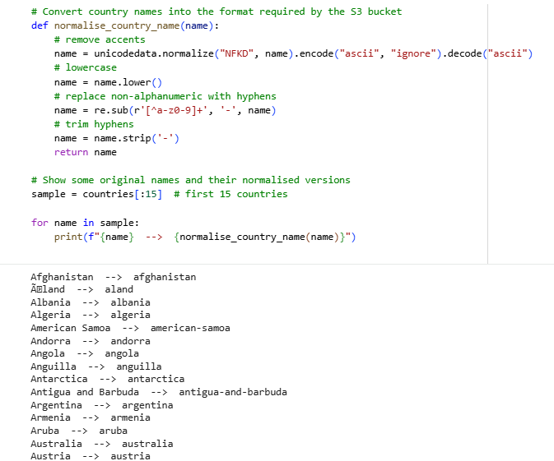
Data Extraction
Extraction Approach
Scraped country list from Berkeley Earth website
Normalised country names to match S3 bucket filenames
Automatically downloaded each country’s temperature file
Parsed raw .txt climate records into structured rows

Slide 5
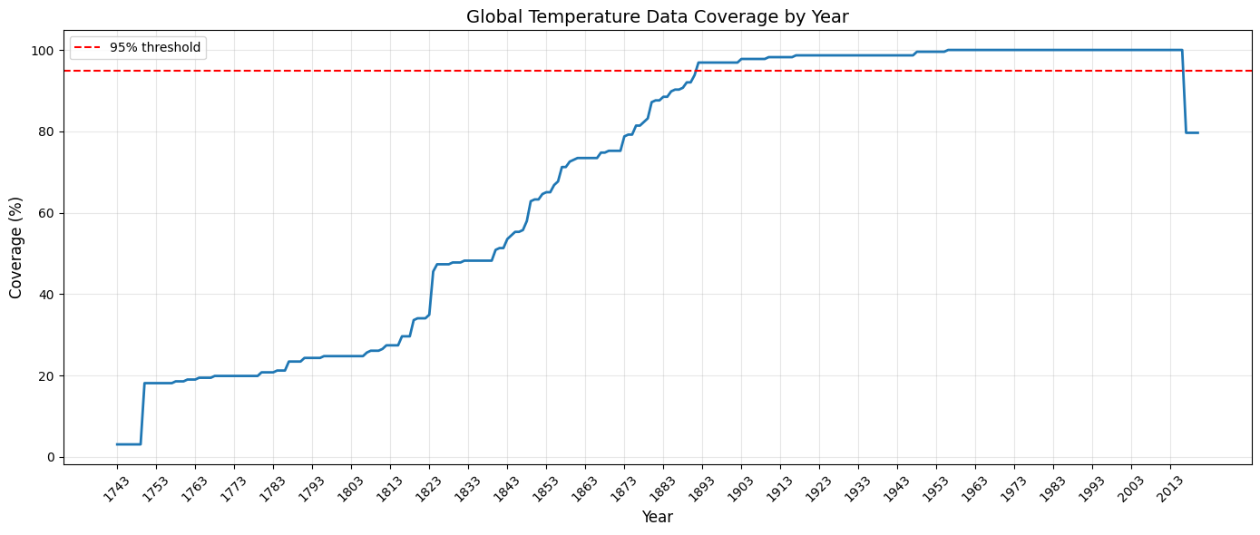
Data Pre-Processing
Cleaning Steps
Parsed raw text files from Berkeley Earth and removed metadata/comment lines.
Dropped malformed rows and ensured only valid (year, month, anomaly) entries were kept.
Standardised column types (converted year and month to integers, anomaly to float).Removed missing anomaly values before analysis and modelling.
Filtered dataset to years with ≥95% global coverage, ensuring fair comparison across countries.
Cutoff year: 1892

Slide 6
Feature Engineering
Warming Trend (°C/year): Linear regression shows how quickly each country is warming over time. Used for the global trend map.
Climate Volatility: Standard deviation of anomalies, highlighting how unstable or extreme temperature patterns are in each country.
Mean Anomaly: Long-term average anomaly, giving a simple measure of overall warming.
Data Coverage Metrics: Minimum year, maximum year, and total records.
Baseline Anomaly & Change From Baseline: Tracks how far temperatures have shifted compared to the earliest available year for each country.
Season Classification: Assigns each month to Winter, Spring, Summer, or Autumn to analyse seasonal warming.
Anomaly Z-Score: Standardises anomalies relative to each country’s own variability. Helps compare extreme heat events between countries with different climates.
Final Output Files:
temperature_data_clean.csv
country_features.csv

Slide 7
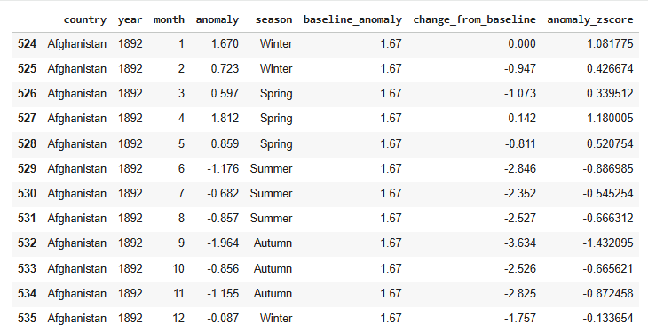
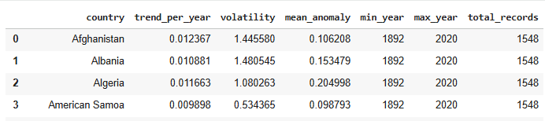
Final Output Sample
temperature_data_clean.csv
country_features.csv

Slide 8
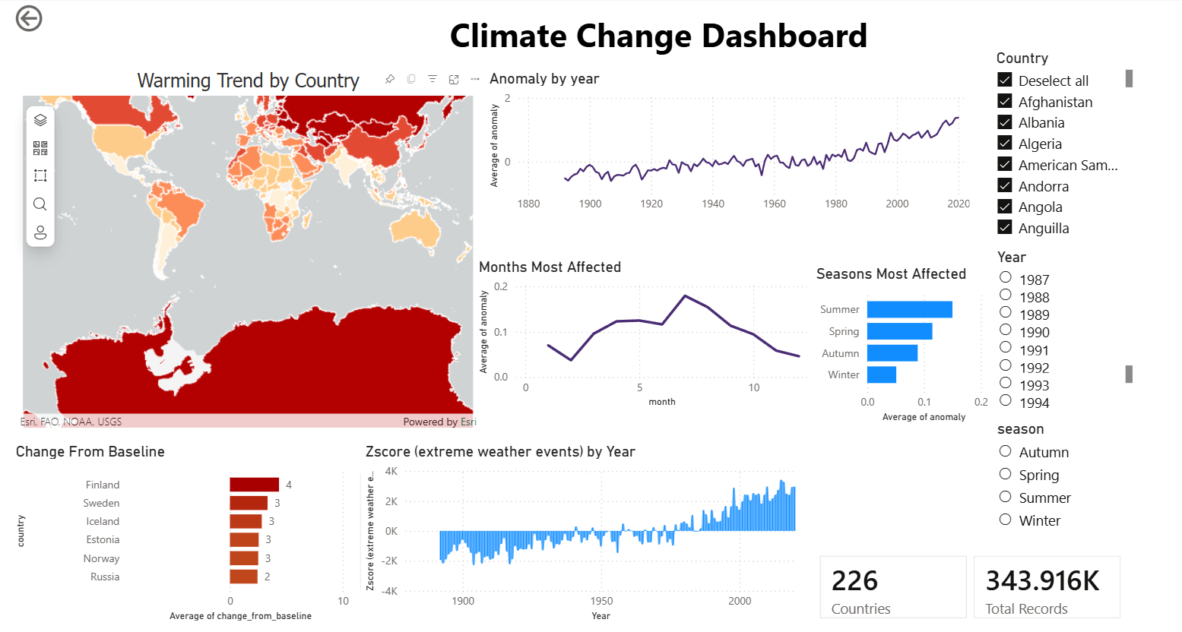
Visualisations in PowerBI

Slide 9
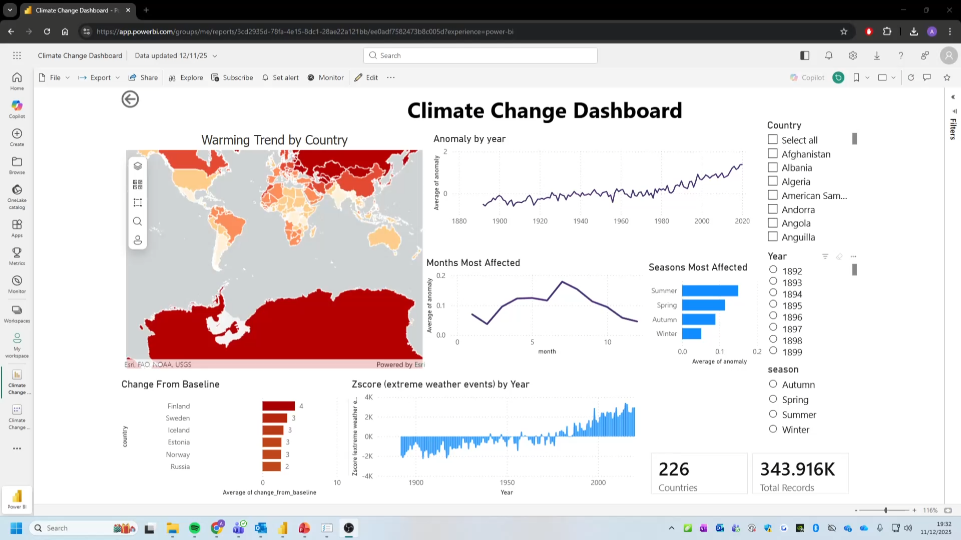
Interactive Dashboard

Slide 10
Key Findings
Global warming has accelerated sharply since the 1970s
Northern regions (Arctic, Scandinavia, Russia) warm fastest
Extreme heat events (high z-scores) increase after ~1980
Summer months show the highest anomalies
Countries differ significantly in climate volatility

